Slide 1
Leo Club Program Overview

Slide 2
Leos: A Vital Branch of the Lions Family Tree
Program Overview & Approach

Slide 3
Lions History
Lions started in 1917.
Lions have over 46,000 clubs and 1.4+ million members and are the largest service organization in the world.
The Lions are the only nonprofit organization in the world to ever be nominated for a Noble Peace Prize.
Lions were asked to become the eyes of the Blind by Helen Keller in 1925 and are known for Eye Glass Program, Eyes Screening, Eye Transport, Seeing Eye Dogs and Eye Surgeries.
Lions mission is to empower volunteers to serve their communities, meet humanitarian needs, encourage peace and promote international understanding through Lions clubs.

Slide 4
Marshall Lions
Over the last 5 years the Marshall Lions are the fastest growing club in Wisconsin.
Last year Marshall Lions raised more than $60,000. All the funds the Lions raise go to helping people in need or towards community projects.
The Marshall Lions participate in over 25 community projects a year.
There are currently more than 90 members in the Marshall Lions.
Marshall Lions Web Site http://www.sightfirst.com

Slide 5
L-E-O Motto
Leadership: Leo members acquire skills as project organizers and motivators of their peers.
Experience: They discover how teamwork and cooperation can bring about change in their community and the world.
Opportunity: Leos develop positive character traits and receive recognition for their contributions.
Program Overview & Approach

Slide 6
Benefits of being a Leo Member
Learn to plan and manage projects
Acquire community service hours (Many scholarships are based upon involvement in the community)
Become a more effective leader
Make Marshall a better place to live
Feel great about yourself by helping others
Enjoy being part of a team and develop comradery with other Leos
Make a difference in your community and in other’s lives
Identify areas of need and with the help of Leos and the Lions make great thing happen you could not accomplish on your own
Become a part of the only nonprofit organization in the world (Lions) to be nominated for a Nobel Peace Prize Award

Slide 7
How does a Leo Club get started?
First a Lions Club needs to agree to sponsor Leo Club
Lions invite youth to an Informational Meeting
Leo Members need to be girls or boys between the age of 12 – 18.
If there is enough interest shown to create a Leo Club a Formation Meeting will be held to elect Leo club officers, discuss potential projects and determine the place and time for club meetings.
Sponsoring Lions clubs needs to appoint a Lion to serve as the Leo Club Advisor and two other members to serve on an Advisory Board members.

Slide 8
Leo Club Officers Duties
Leo Club Presidents manage club and board meetings.
Leo Club Vice Presidents assists the president and assume the president’s duties if he or she cannot complete the term.
Leo Club Secretaries maintain records of officers, committee appointments, members, attendance and service activity reports.
Leo Club Treasurers receive and deposit all club money, disburse club funds and complete monthly financial statement.
Leo Club Board of Directors consists of the Leo club president, vice president, secretary, treasurer and three elected Leo club members. This group also executes the business of the club, including the authorization of all club expenses.

Slide 9
Leo Club Meetings
Sponsoring Lions clubs shall provide an advisory board consisting of three Lions. The Advisory Board meets with Leo Club Officers to mentor and consult them on Leo Club projects.
Leo Clubs typically hold monthly meetings and are responsible for running their club meetings.
Program Overview & Approach

Slide 10
The Global Scope of the Leo Movement
Members: 167,875
Clubs: 6,715
Countries: 144
Program Overview & Approach

Slide 11
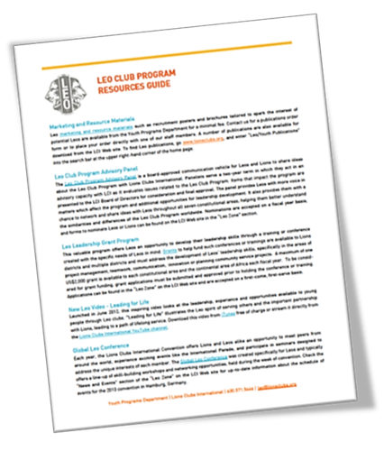
Leo Club Charter Materials:
Upon Chartering a New Leo Club
Leo lapel pins for each original member of the new Leo club
Omega Leo Club Sponsor Kit
Omega Leo Club Officer Kit
Certificate of Organization
Leo Club Program Resources

Slide 12
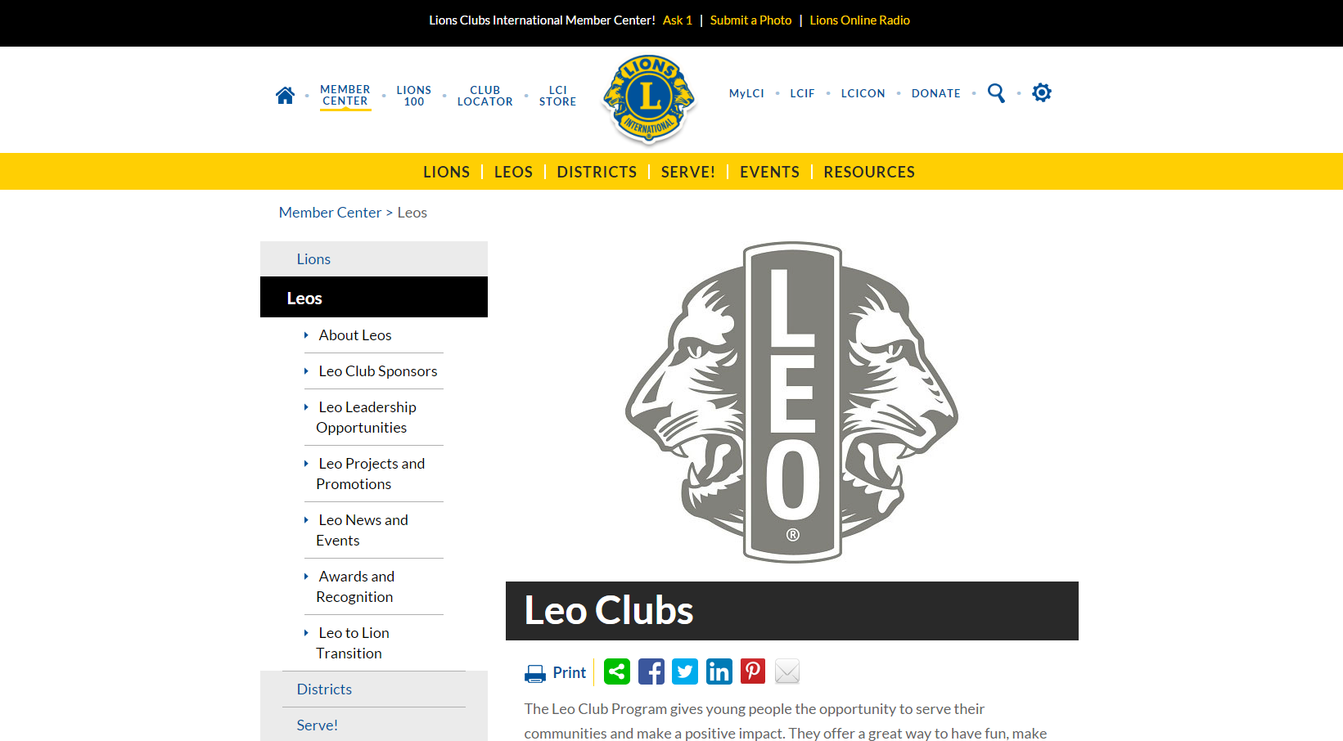
Leos on the LCI Website
www.lionsclubs.org/leoclubs
Leo Club Program Resources

Slide 13
Leo Club Program Resources from LCI
Leo Marketing and Recruitment Materials
Leo Items from LCI Club Supplies
Leo section of the LCI Website
Leo eNews
Leo Facebook Page
E-LeoClubhouse Website
MyLCI for Leos
Lions Learning Center on the LCI Website
Lions Leadership Institutes and Seminars
Leo Leadership Grant Program
Leo Club Program Advisory Panel
Leo Events at Lions Clubs International Convention
Awards and Recognition

Slide 14
Leo Facebook Page
www.facebook.com/leoclubs

Slide 15
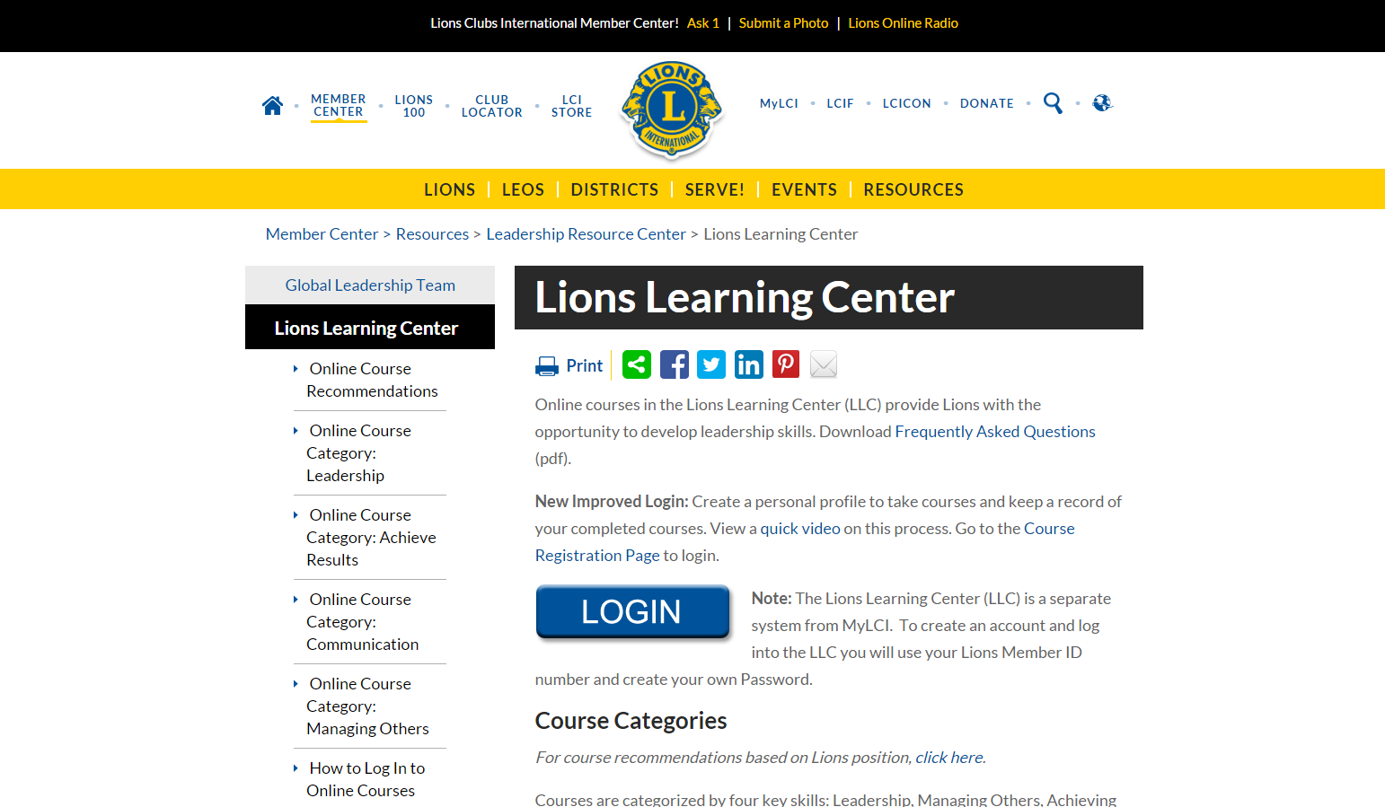
Lions Learning Center
Notes:
.

Slide 16
Interested in becoming a Leo Club Member?
If you are interested in becoming a Leo Club Member please contact Dave Easley (easleydj@frontier.com) (608 698 5526). Dave will send you to the Leo Club Formation Meeting which will be held in the middle of July.

